Slide 1
Review of Chapter 6
(1)
Let f be a piecewise continuous function defined on [-L,L].
We would like to represent f by

Slide 2
First note that
is 2L periodic function. So for convenience, we extend
f to the whole real line and f is 2L periodic function.
Is

Slide 3
ANSWER
Let f be a 2L periodic function such that f and f´ are
piecewise continuous.
(1) If
is continuous at the point
then
(2) If is discontinuous at , then

Slide 4
(2)
(A) Suppose f is even, then
Hence the Fourier Series of f is
called Fourier cosine series
(B) Suppose f is odd, then
Hence the Fourier Series of f is
called Fourier sine series

Slide 5
(3)(A)
Suppose f is defined on [0,L]
Then we may extend f to be on [-L,0]
such that f is even
Hence the Fourier series of the extended function f
on [-L,L] is
called half-range Fourier series or half-range expansion

Slide 6
(3)(B)
Suppose f is defined on [0,L]
Then we may extend f to be on [-L,0]
such that f is odd
Hence the Fourier series of the extended function f
on [-L,L] is
called half-range Fourier series or half-range expansion

Slide 7
(4)
Before we compute the Fourier coefficients
We will check whether the given function
is odd, even, or not odd not even
How to check?
even even=even
odd odd= even
odd even= odd

Slide 8
(4)(cont)
If you can’t see from the given function,
then you can sketch the graph of the function f.
From the graph, we can see easily and get the answer.
If the given function is piecewise continuous, then we need to sketch the graph piece by piece
From the graph, we also know the discontinuous points,
so we will know where f(x)=F S of f at x.

Slide 9
(5)
Functions f in Chapter six may be constant,
so formulae of integrals given
in my lecture slide “some useful facts” may be useful

Slide 10
(6)
The answers of coefficients of Fourier series always
have the following terms

Slide 11
(6)(cont)
For example,

Slide 14

♣
(2005)

Slide 15

(2008)
f is continuous everywhere, just look at the values of f at endpts

Slide 16




This part is optional

Slide 17
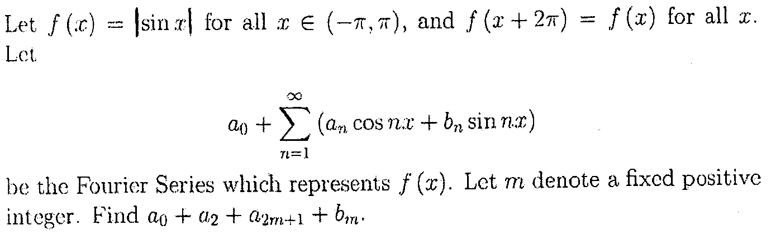
♣
(2007)

Slide 18
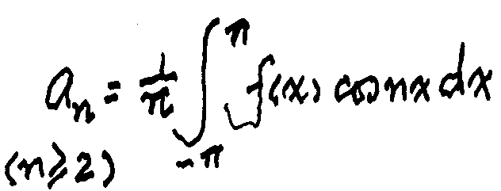



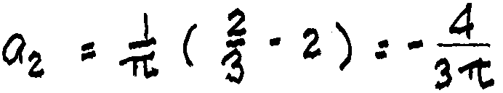
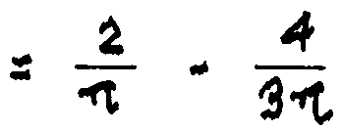
●

Slide 19
(7)
Suppose f is 2L periodic function
However the function is given on [0,2L]
Can we still apply the formula
2L periodic
ANS:YES

Slide 20
(8)
Fourier series of
is
Therefore
for all x
Since f is continuous at every pt x

Slide 21
Now we shall look at some special points to get
some interesting equalities. Try
Let
get
So

Slide 22
Let x=0, subst into
get

Slide 23
(9)
(A)
Let
which is 2π periodic function
What is the F S of f?
Since F S of f is of the form
i.e.,
Hence
So the F S of f is the function f itself

Slide 24
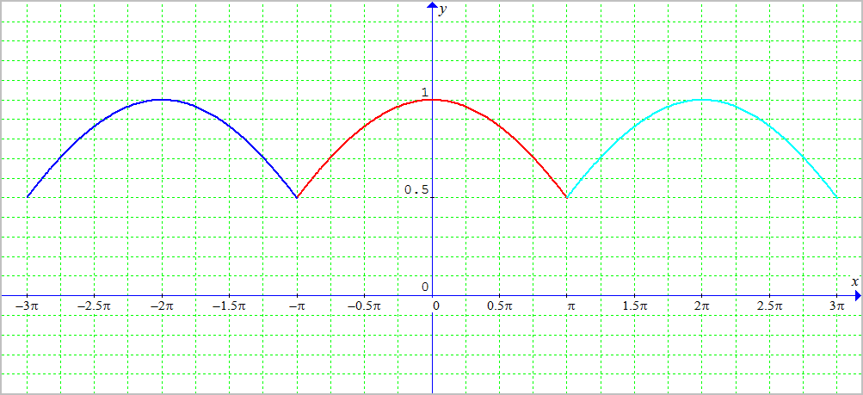
(B)
Let
on
Is the F S of f is the function f itself?
ANS: No, No
Since the F S of 2π periodic function is of the form
is not of the form cos nx

Slide 25
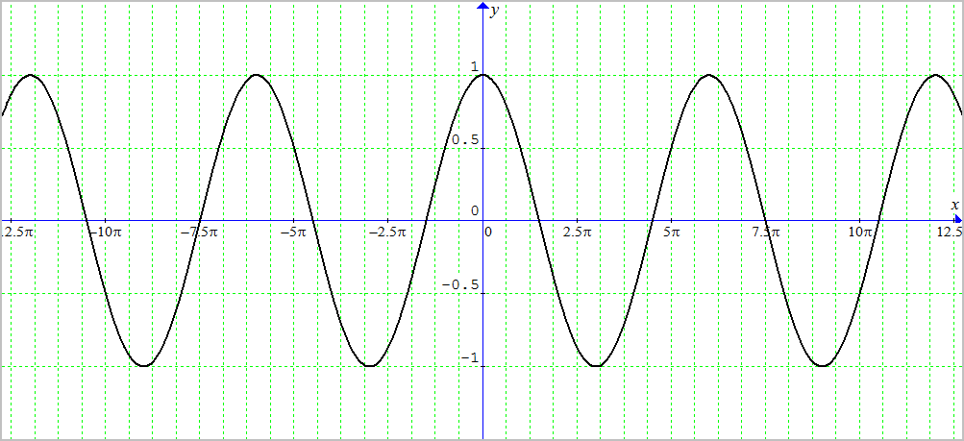
(B)(cont.)
However if
Is the F S of this 2(3π) periodic function g
is the function g itself?
ANS: YES, YES
Since the F S of 2(3π) periodic function is of the form

Slide 26
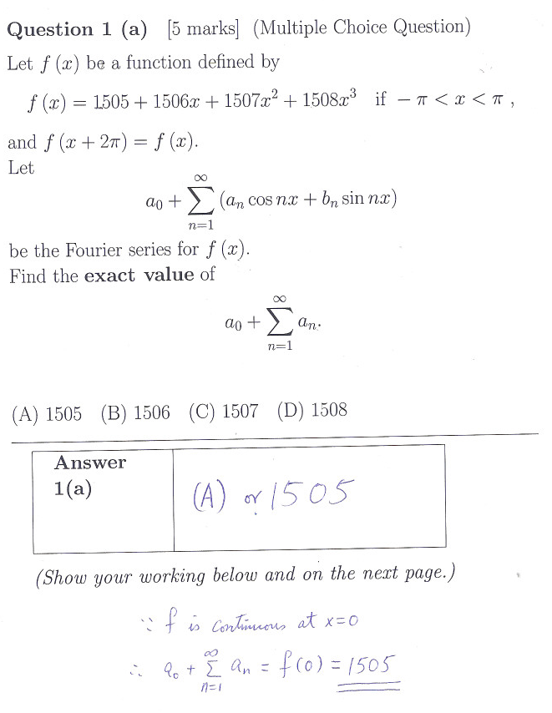
2012

Slide 27
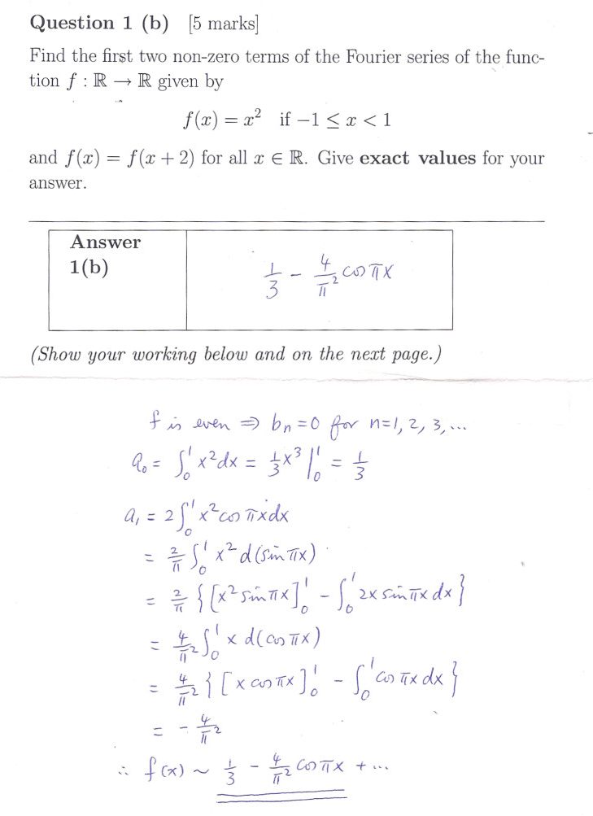
2012

Slide 28
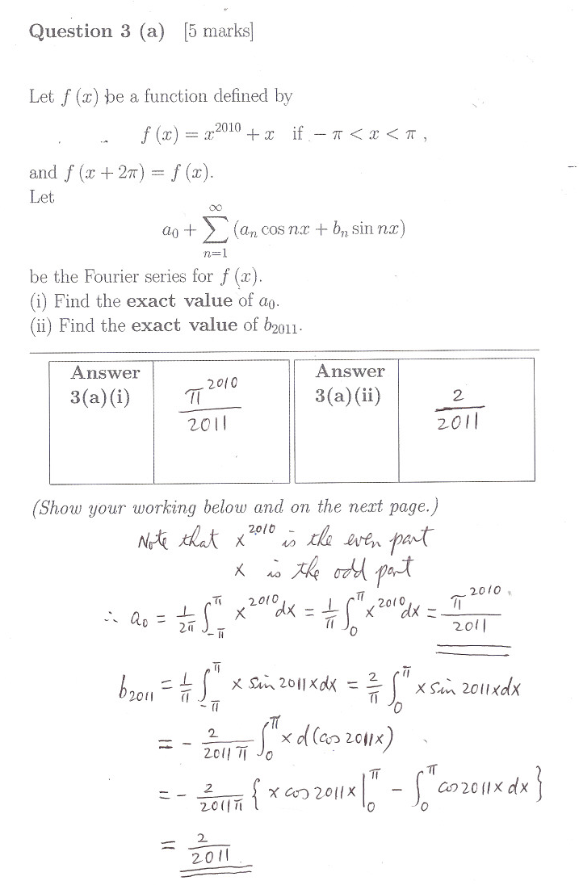
2011

Slide 29
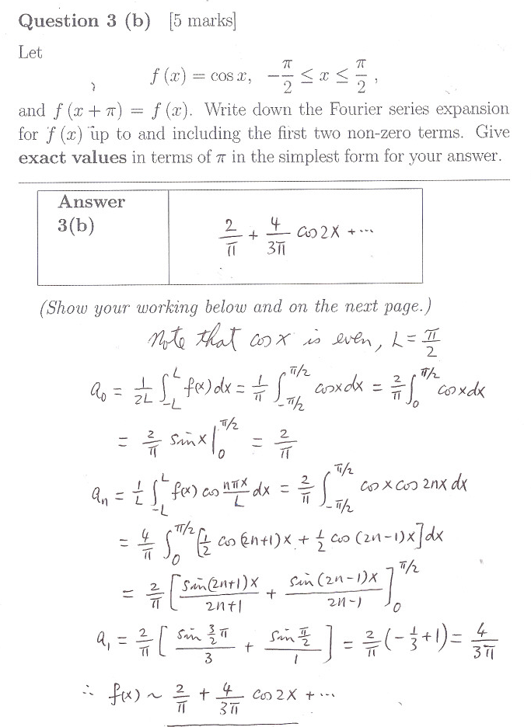
2011

Slide 30
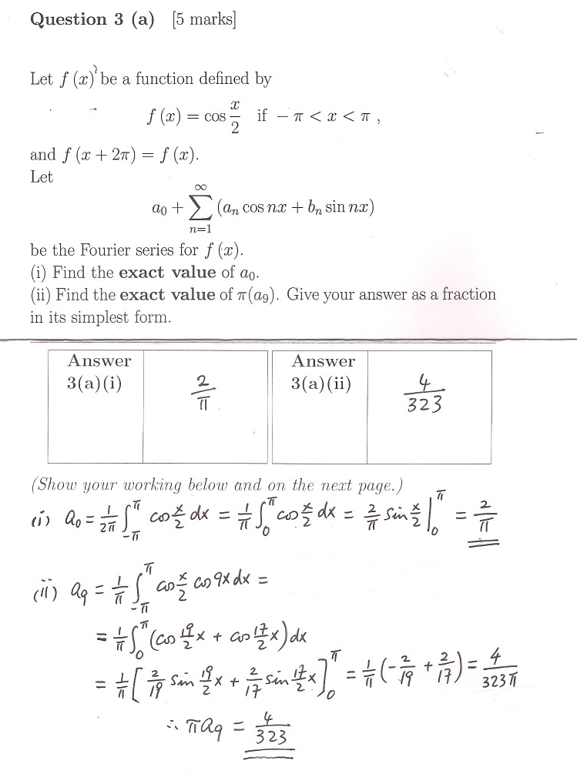
2010

Slide 31
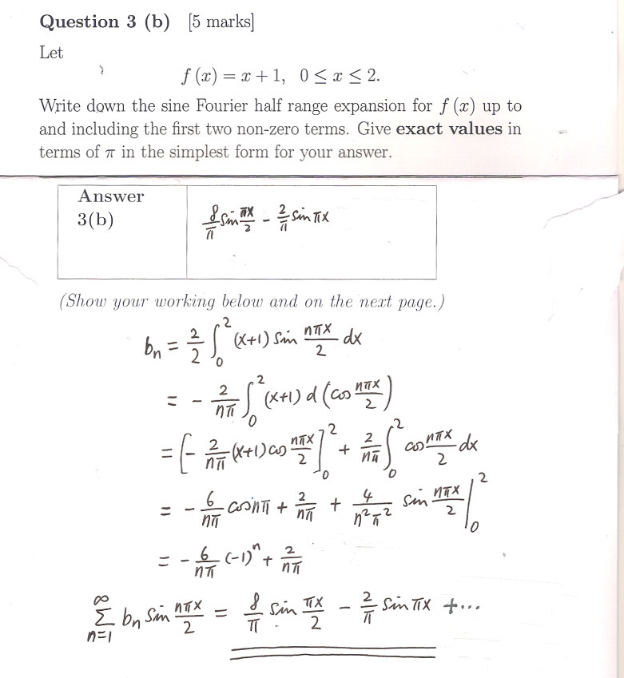
2010

